Slide 1
Red-Black Trees
Emdad Khan 1 9/13/2015

Slide 2
Red-Black Tree
Wholeness of the Lesson
Red-black trees provide a solution to the problem of unacceptably slow worst case performance of binary search trees. This is accomplished by introducing a new element: nodes of the tree are colored red or black, adhering to the balance condition for red-black trees. The balance condition is maintained
Emdad Khan 1 9/13/2015

Slide 3
Red-Black Tree
during insertions and deletions and doing so introduces only slight overhead.
Science of Consciousness: Red-black trees, as an example of BSTs with a balance condition, exhibit the Principle of the Second Element for solving the problem of skewed BSTs.
Emdad Khan 1 9/13/2015

Slide 4
Review: Binary Search Trees
Binary Search Trees (BSTs) are an important data structure for dynamic sets
In addition to satellite data, eleements have:
  key: an identifying field inducing a total ordering
  left: pointer to a left child (may be NULL)
  right: pointer to a right child (may be NULL)
  p: pointer to a parent node (NULL for root)
Emdad Khan 1 9/13/2015

Slide 5
Red-Black Trees
Red-black trees:
  Binary search trees augmented with node color
  Operations designed to guarantee that the height
  h = O(lg n)
First: describe the properties of red-black trees
Then: prove that these guarantee h = O(lg n)
Finally: describe operations on red-black trees
Emdad Khan 1 9/13/2015

Slide 6
Red-Black Properties
The red-black properties:
  1. Every node is either red or black
  2. Every leaf (NULL pointer) is black
    Note: this means every “real” node has 2 children
  3. If a node is red, both children are black
    Note: can’t have 2 consecutive reds on a path
  4. Every path from node to descendent leaf contains the same number of black nodes
  5. The root is always black
Emdad Khan 1 9/13/2015

Slide 7
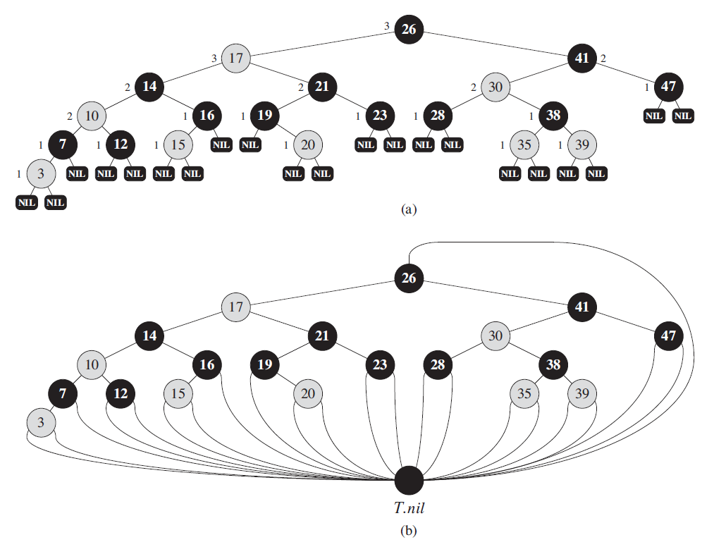
Red-Black Tree Example
Emdad Khan 1 9/13/2015

Slide 8
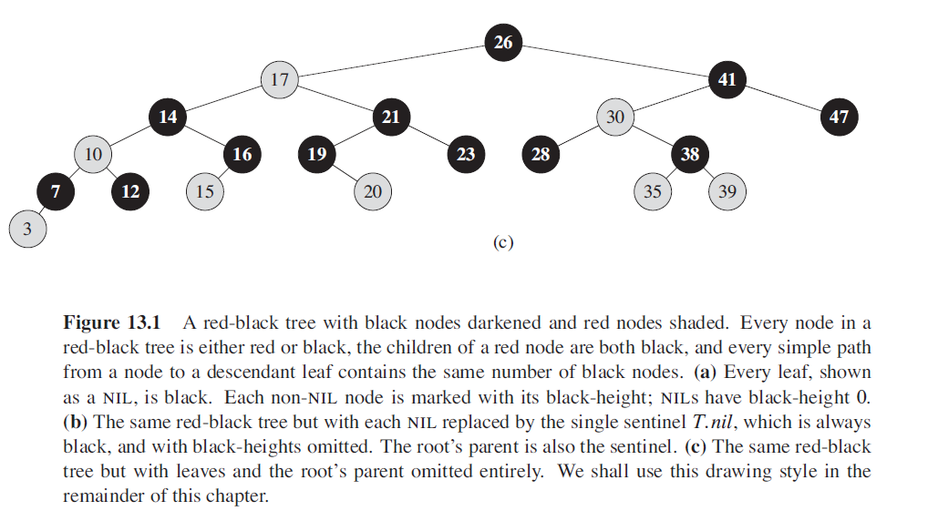
Red-Black Tree Example
Emdad Khan 1 9/13/2015

Slide 9
Height of Red-Black Trees
What is the minimum black-height of a node with height h?
A: a height-h node has black-height ≥ h/2
Theorem: A red-black tree with n internal nodes has height h ≤ 2 lg(n + 1)
How do you suppose we’ll prove this?
Emdad Khan 1 9/13/2015

Slide 10
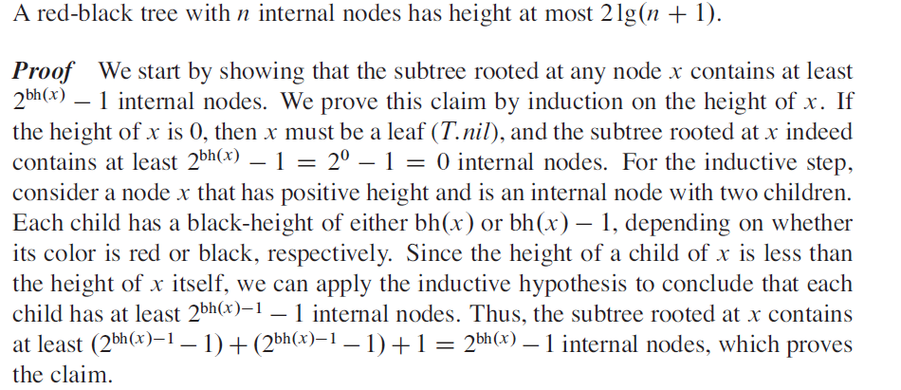
Red-Black Properties: Some Proof
Emdad Khan 1 9/13/2015

Slide 11
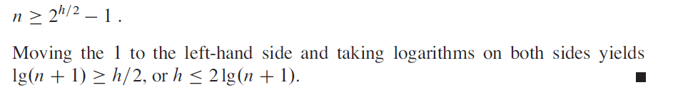
Red-Black Properties
The Black Height must be at least h/2. Hence,
Emdad Khan 1 9/13/2015

Slide 12
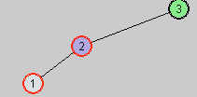

Red-Black Tree: Some Key Cases
(Rotation – for balance)
→
Emdad Khan 1 9/13/2015

Slide 13
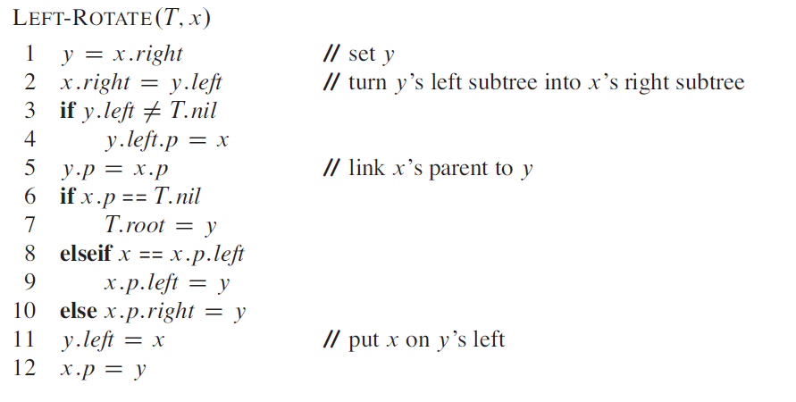
More on Rotation
Emdad Khan 1 9/13/2015

Slide 14
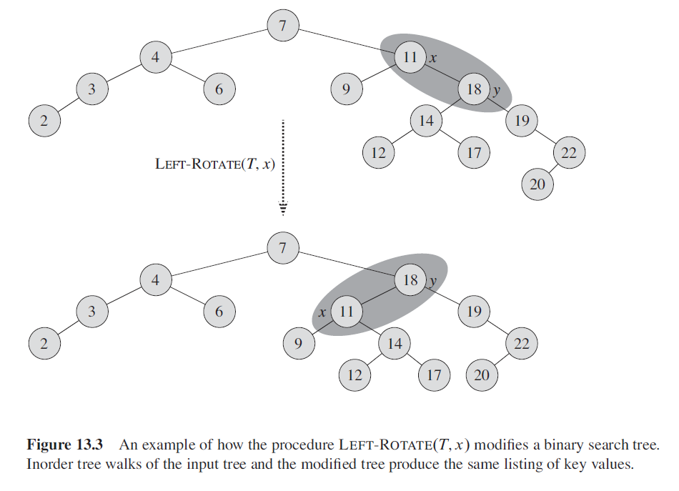
More on Rotation
Emdad Khan 1 9/13/2015

Slide 15
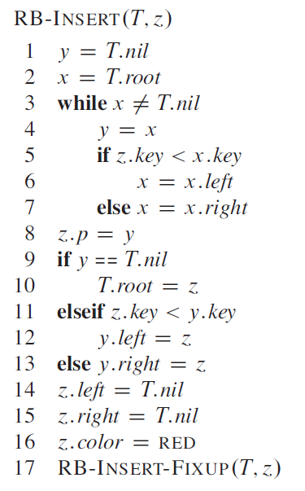
RB Insert
Emdad Khan 1 9/13/2015

Slide 16
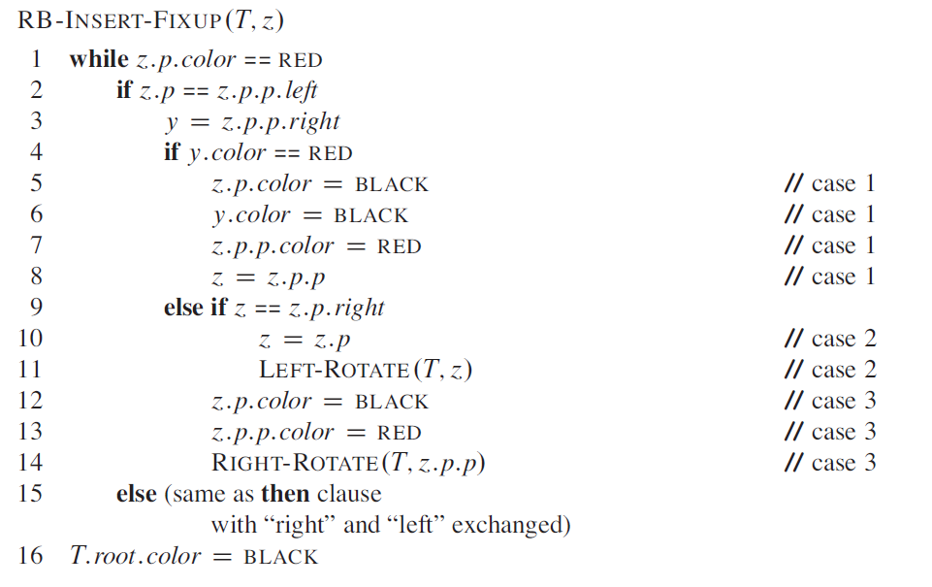
RB Insert
Emdad Khan 1 9/13/2015

Slide 17
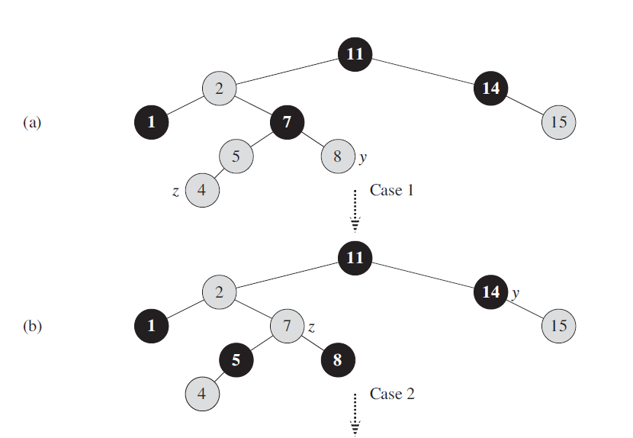
RB Insert
Emdad Khan 1 9/13/2015

Slide 18
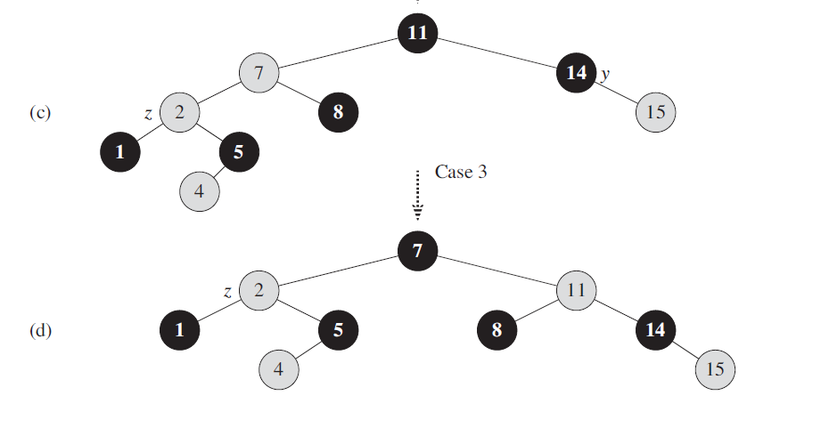
RB Insert
Emdad Khan 1 9/13/2015

Slide 19
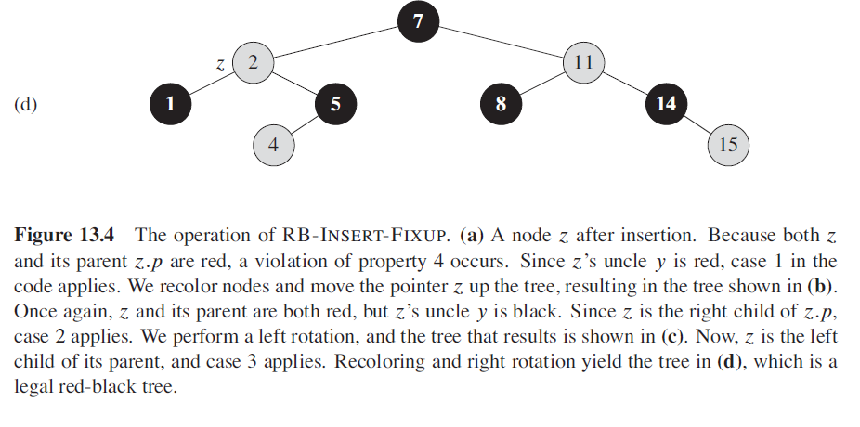
RB Insert
Emdad Khan 1 9/13/2015

Slide 20
RB Insert (Repeated for Conveni.)
Emdad Khan <number> 11/07/26

Slide 21
Red-Black Insertion
Code – No Case

Slide 22
Red-Black Insertion
Code – Case 3
[Right Rotate]
z

Slide 23
Red-Black Insertion
Code – Case 3
-> Middle node
becomes root &
black
-> Root node
becomes right
node & red

Slide 24
Red-Black Insertion
Code – Case 1
(Just color change)
y
z

Slide 25
Red-Black Insertion
Code – Case 1
(Just color change
Including
T.root.color)
y
z

Slide 26
Red-Black Trees: Key Comments
So, the trick is to use Red and Back labels to nodes and use appropriate rules to manipulate nodes in such a way that makes the tree balanced after inserting a new value.
The same is true for Deletion (we will cover it in lab problems).
Emdad Khan 1 9/13/2015

Slide 27
RB Trees: Worst-Case Time
We’ve proved that a red-black tree has
O(lg n) height
Corollary: These operations take O(lg n) time:
  Minimum(), Maximum()
  Successor(), Predecessor()
  Search()
Insert() and Delete():
  Will also take O(lg n) time
  But will need special care since they modify tree
Emdad Khan 1 9/13/2015

